Slide 1
389- R.N. SHETTY POLYTECHNIC
Shivabasav Nagar, Belagavi
COMPUTER SCI. & ENGG (CSE)
Presentation on:
ONLINE COURSE
( DESIGN THINKING)
By
Mr. ayyan I kamate reg.no. 389CS22008
Guided by
smt. Priyadarshini s.d. LECT./CS.
5th semester (2024-25)

Slide 2
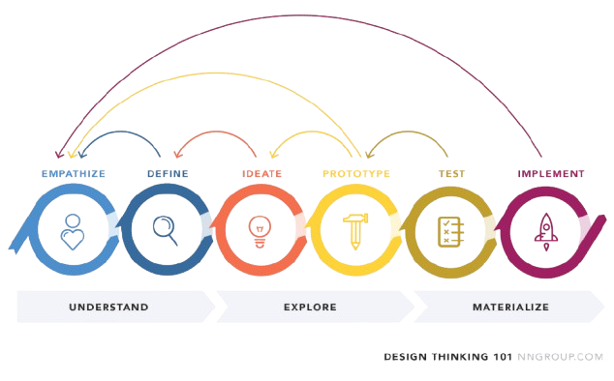
DESIGN THINKING:

Slide 3
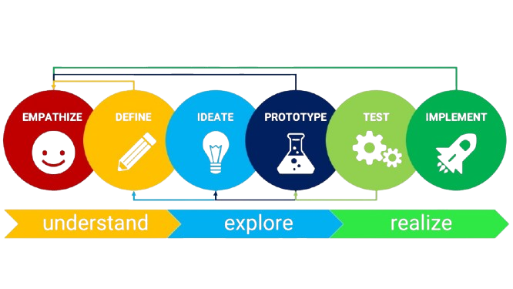
DESIGN THINKING:

Slide 4
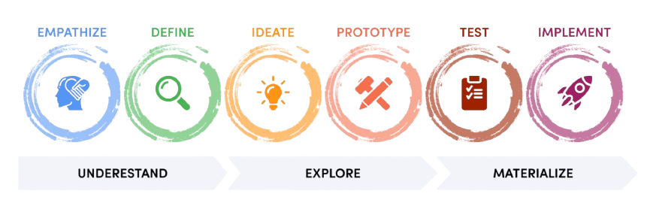
DESIGN THINKING:

Slide 5

DESIGN THINKING:

